Slide 1

SE401 - Software Quality Assurance and Testing
Life Cycle-Based Testing

Slide 2
Outlines
Levels and Life Cycle Models
The Waterfall Lifecycle
Testing in Iterative Life Cycles
Agile Testing
Open Questions

Slide 3
Levels and Life Cycle Models
Levels of testing depend primarily on the software life cycle used.
BUT, most forms of testing levels are derived from the V-Model version of the good, old Waterfall Model.
Iterative models introduce the need for regression testing.
System testing is greatly enhanced when an executable specification is used.

Slide 4
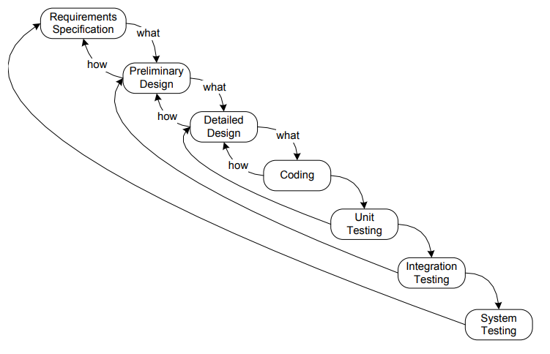
The Waterfall Lifecycle

Slide 5
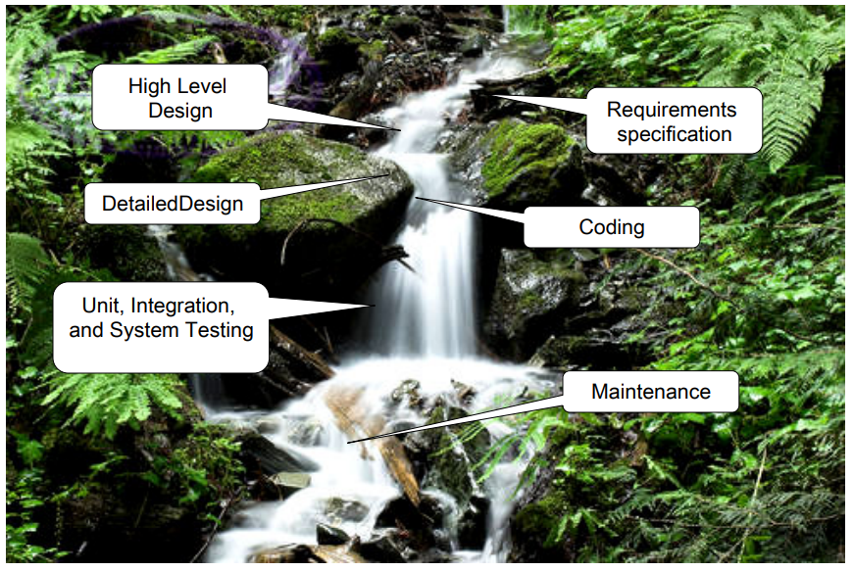

Slide 6
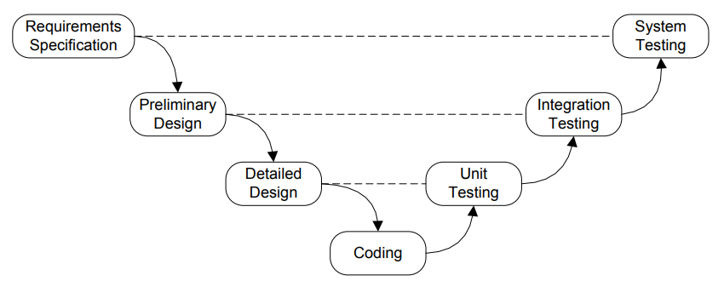
The V-Model

Slide 7
Evaluation of the Waterfall Model
Advantages
hierarchical structure maps nicely into large projects
phases have well-defined end products
Unit level work can be done in parallel, reducing overall project interval
Disadvantages
Extremely long feedback cycle for customer
Very late synthesis (begins at integration testing)
Staff limitations may not support the advantage of massive parallel development at the unit level
Requires “perfect foresight”, otherwise early faults propagate

Slide 8
Spin-off Models
Practitioner responses to waterfall limitations
Iterative Development
The Spiral Model
Rapid Prototyping
Executable Specification
Agile models
Scrum
eXtreme Programming (XP)
Test-Driven Development
Two promising hybrids
Agile Model-Driven Development (AMDD)
Model-Driven Agile Development (MDAD)

Slide 9
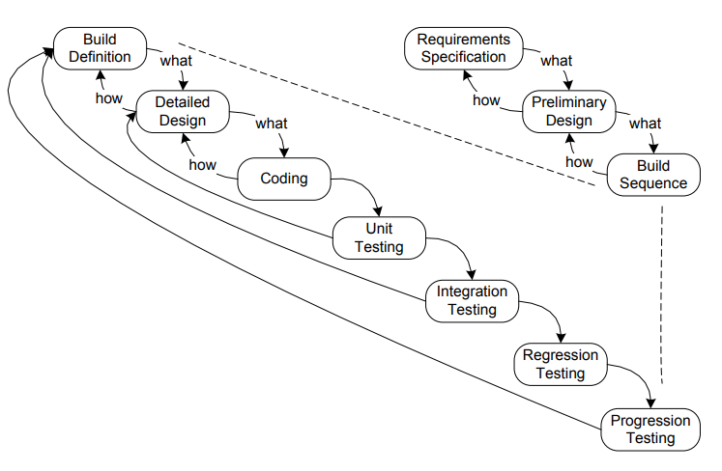
Iterative Development

Slide 10
Iterative Development
Preserves a single high level design phase
amortizing design across increments is risky. Early design decisions may eliminate later design choices
defines the sequence and content of “builds” (or increments)
Builds create the need for regression testing
Preserves the advantages of Waterfall, AND
Responds to Waterfall defects
staffing limitations
late synthesis
long feedback cycle with customer

Slide 11
“Perfect Foresight?”
Waterfall and the iterative variations have no answer for the customer who does not have a clear, complete idea of what is needed.
“Requirements Elicitation” is the process of helping customers and developers reach a common understanding of a proposed system.
Three lifecycle responses...
Rapid Prototyping
Executable Specification
the Agile methods

Slide 12
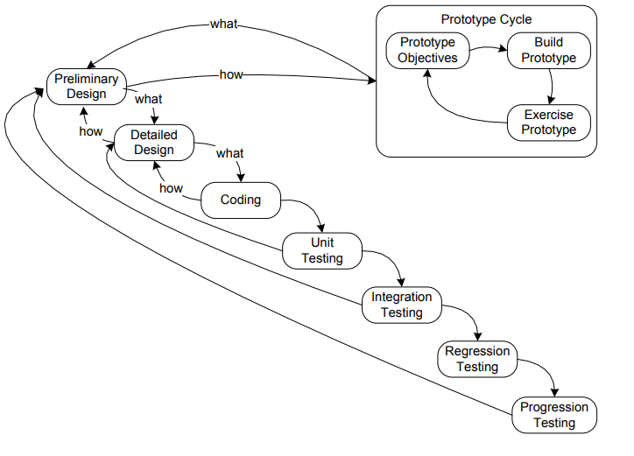
Rapid Prototyping

Slide 13
Rapid Prototyping
Helps customer identify needs and defects
“I’ll know what I want when I see it.”
provides the “does view” that customers appreciate
ideal to give the “look and feel” of menu-driven systems
modify prototype per customer feedback
Sometimes done for feasibility
Advantages:
improved and early feedback with customer
better basis for design
Keep or dispose?
once it has served its purpose, the prototype can be archived.
possible to use to identify test scenarios

Slide 14
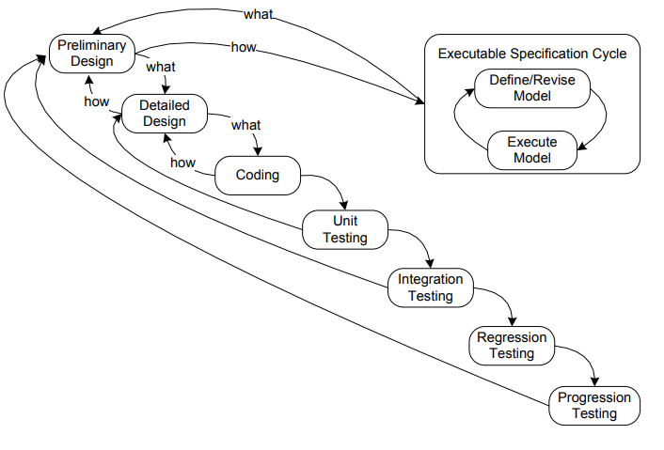
Executable Specification

Slide 15
Executable Specification
Very similar to Rapid Prototyping
early feedback
“look and feel”
Best for event-driven systems
Executable model is the specification
finite state machine
StateChart
some form of Petri Net
Need an “engine”
model is executed by the engine
usually interactively with customer

Slide 16
Evaluation of Executable Specification
Intended for “reactive systems” (event-driven)
Advantages
early feedback
automatic generation of system test cases
can be used for operator training
support for early analysis
Disadvantages
modeling can be difficult
training may be necessary
engine can be expensive

Slide 17
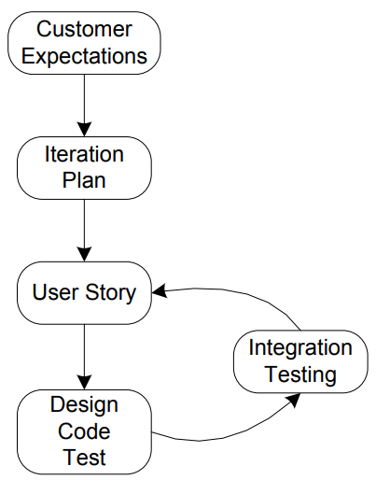
Generic Agile Lifecycle

Slide 18
Agile Development
Best response to the customer who does not know what is needed, i.e., “perfect foresight”
Customer-driven, hence excellent customer feedback
Short increments (early synthesis)
We look at
eXtreme Programming (XP)
Test-Driven Development (TDD)
Scrum

Slide 19
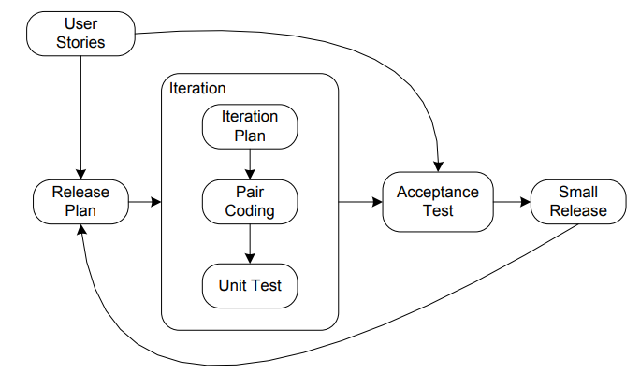
eXtreme Programming

Slide 20
eXtreme Programming
Distinguishing characteristic: pair programming
one person has the detailed view (and the keyboard)
partner has the overall view, and acts as a constant reviewer
roles can change
Bottom-up development precludes a single, high level design phase
(but that might not be possible with an uncertain customer anyway)

Slide 21
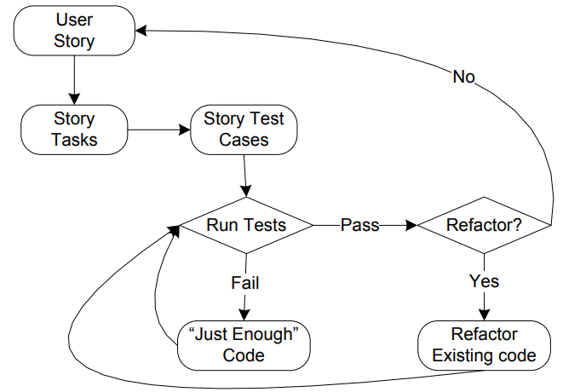
Test-Driven Development (TDD)

Slide 22
Test-Driven Development (TDD)
Extreme case of agile development
Bottom-up development based on test cases
derived from customer-provided user stories
very quick feedback
Very small increments
early synthesis
excellent fault isolation
refactoring results in clean code
BUT, no opportunity for a comprehensive design

Slide 23
TDD Example: a Boolean Function to Determine Leap Years
Definition: A year is a leap year if it is a multiple of 4, but century years are leap years only if they are multiples of 400.
Test-Driven Development would break this into small, individual user stories (also called tasks).
“Coded” here in a pseudo-code (a lingua franca) that resembles Visual Basic.

Slide 24
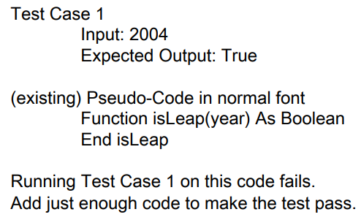
User Story 1: A year divisible by 4 is a leap year

Slide 25
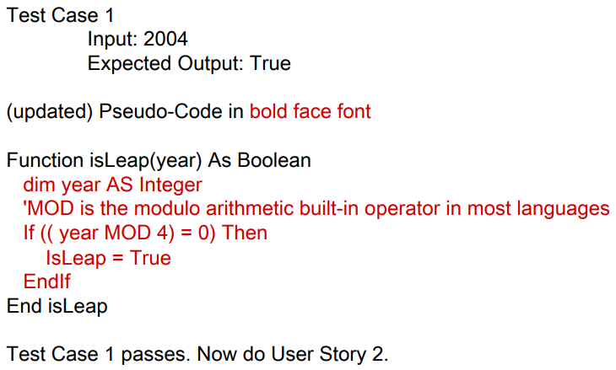
User Story 1: A year divisible by 4 is a leap year

Slide 26
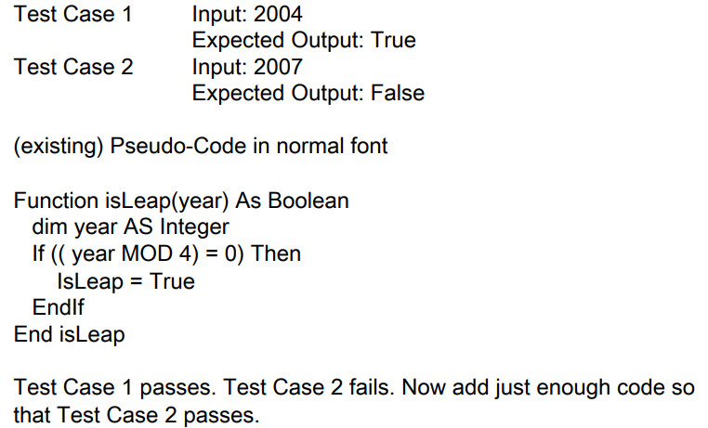
User Story 2: A year not divisible by 4 is a common year

Slide 27
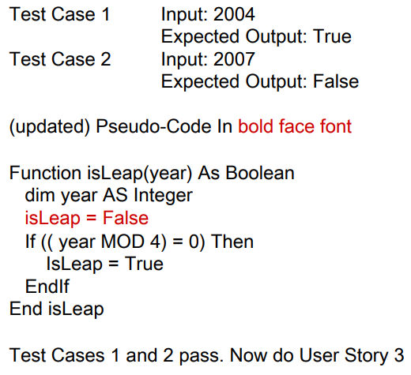
User Story 2: A year not divisible by 4 is a common year

Slide 28
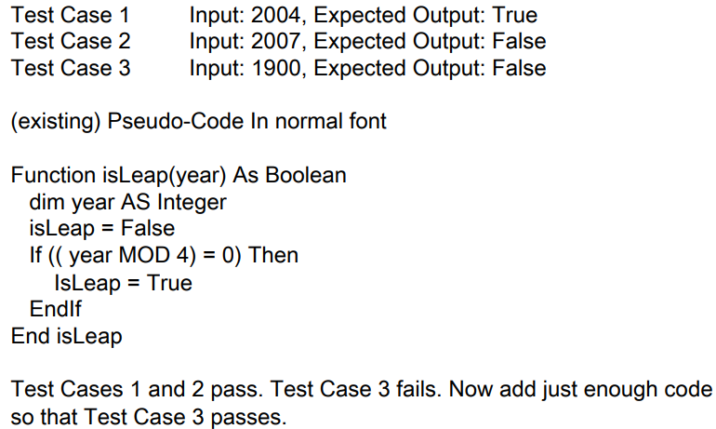
User Story 3: A century year not divisible by 400 is a common year

Slide 29
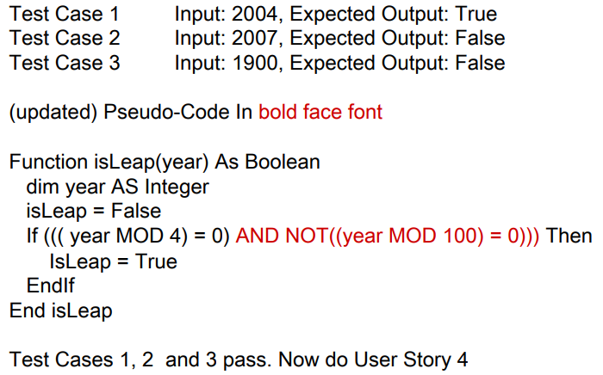
User Story 3: A century year not divisible by 400 is a common year

Slide 30
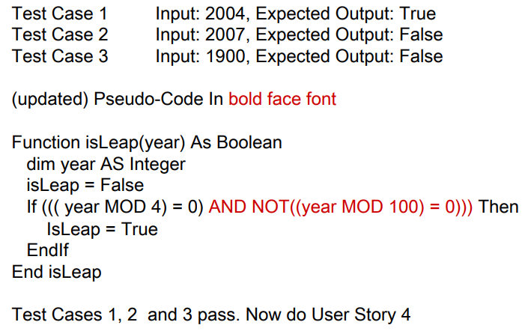
User Story 3: A century year not divisible by 400 is a common year

Slide 31
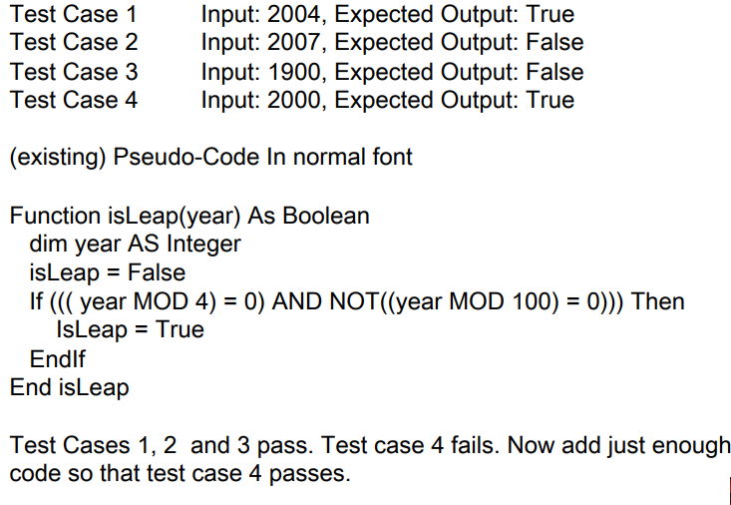
User Story 4: A century year divisible by 400 is a leap year

Slide 32
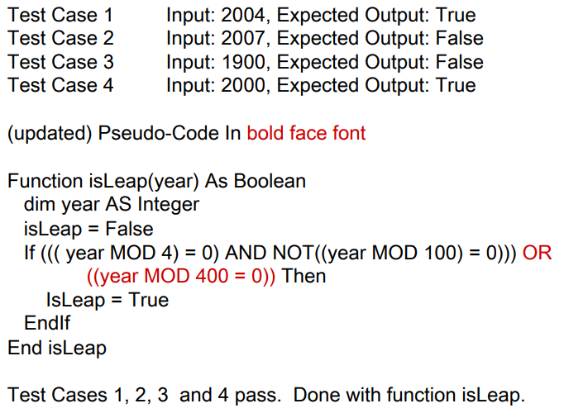
User Story 4: A century year divisible by 400 is a leap year

Slide 33
Advantages of Test Driven Development
In this example, the steps are deliberately small.
Customer and developer can (should!) jointly determine granularity of user stories.
Fault isolation is greatly simplified (in fact, trivial). If a test case fails, the fault must be in the most recently added code.
Once a new test case passes, a working (subset) of the desired software can always be delivered.
Something always works!

Slide 34
Disadvantages of Test Driven Development
Useful granularity is an issue.
There is no guarantee that user stories “arrive” in a sensible order.
There is no guarantee that user stories are the “same size” (or require similar effort)
Bottom-up coding often results in poorly structured code, making refactoring necessary.
Tool support (e.g. jUnit) is essential.

Slide 35
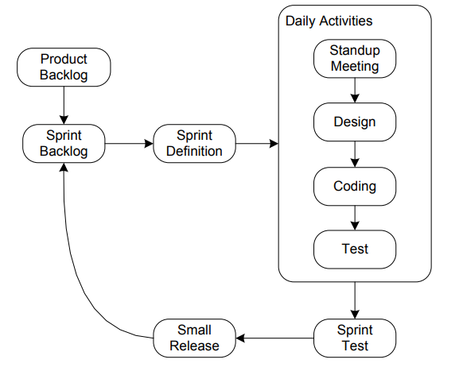
Scrum Lifecycle

Slide 36
Scrum—New Terms for Existing Ideas
Three roles
Product owner
Scrum Master
Self-organizing team
Three ceremonies
Sprint planning meeting
Daily scrum meeting
Sprint review meeting
Three artifacts
Product backlog,
Sprint backlog
Burndown chart

Slide 37
Product Owner Responsibilities
Define the features of the product;
Decide on release date and content;
Be responsible for the profitability of the product (ROI);
Prioritize features according to market value;
Adjust features and priority every 30 days, as needed; and
Accept or reject work results.
Question: Product Owner = Customer?

Slide 38
Scrum Master Responsibilities
Ensure that the team is fully functional and productive
Enable close cooperation across all roles and functions
Remove barriers
Shield the team from external interferences
Ensure that the process is followed (sprint planning, daily meeting, sprint review)
Question: Scrum Master = Supervisor?

Slide 39
Scrum Team Responsibilities
Cross-functional with 7 +/- 2 members
Selects the Sprint goal and specifies work results
Has the right to do everything within the boundaries of the project guidelines to reach the Sprint goal
Organizes itself and its work
Demonstrates work results to Product Owner.
Question: Scrum Team = Development Team?

Slide 40
Open Questions
Does Agile (bottom up) Development actually result in better designs?
Can any form of Agile Testing reveal “deep faults”?
e.g.: faults revealed only by data flow (define/use) testing
computational faults
time-dependent faults
What about maintenance? Agile code has
well-named variables and components
(hopefully) been refactored carefully
no comments
test cases are the specification

Slide 41
Summary
Levels and Life Cycle Models
The Waterfall Lifecycle
Testing in Iterative Life Cycles
Agile Testing
Open Questions

